Slide 1
GET TRAINED©
A program for school nurses to train school staff to administer epinephrine using an auto-injector
© 2015

Slide 2
Get Trained 2021-2022 Updates
Information in this presentation was reviewed and updated in May 2022 by:
Rhonda Dial Locklear, RN, BSN, CSN

Slide 3
115C-375.2A-Local school boards could authorize school staff to provide some medical care to students, including administration of medication prescribed by a doctor upon written request of the parents, to give emergency health care when reasonably apparent circumstances indicate that any delay would seriously worsen the physical condition or endanger the life of the pupil, and to perform any other first aid or lifesaving techniques.
It’s time for all school staff to
GET TRAINED
to administer an epinephrine auto-injector
in an emergency!
This program is supported by an unrestricted grant from Mylan

Slide 4
What Would You Do?
Bianca has a bee sting allergy
Her class is on a field trip
She tells the teacher that she was stung –
The teacher sees that she is
pale and can hear that she is
wheezing
Her tongue starts to swell,
she gasps for air
Bianca is experiencing
anaphylaxis
Bianca

Slide 5
You have moments to react
Bianca is having a life-threatening allergic reaction
Without prompt treatment with a drug called epinephrine, Bianca could die within minutes
Do you know what to do?
Do you know how to give epinephrine?

Slide 6
BE EMPOWERED TO SAVE A LIFE -

Slide 7
Objectives
Learn the signs and symptoms of anaphylaxis
Have the skills to administer an epinephrine auto-injector
Review the use of an Emergency Care Plan in responding to a student health emergency
Learn to save the life of a child like Bianca!

Slide 8
What is Anaphylaxis?

Slide 9
What is an allergic reaction?
An allergy occurs when the immune system mistakenly attacks a food protein or normally harmless substance – it perceives the food or substance as a harmful or foreign one
Exposure to the offending food or allergen may trigger the sudden release of chemicals, including histamine, resulting in symptoms of an allergic reaction
The symptoms may be mild or severe – may progress over minutes or hours
FARE, 2015

Slide 10
Allergic Reactions
Common things people are allergic to (allergens) include:
Bee stings
Latex
Food Allergies - most common allergens:
FARE, 2015
Peanut | Tree nuts (walnuts, cashews, pecans, etc.)
Milk | Egg
Wheat | Soy
Fish | Shellfish

Slide 11
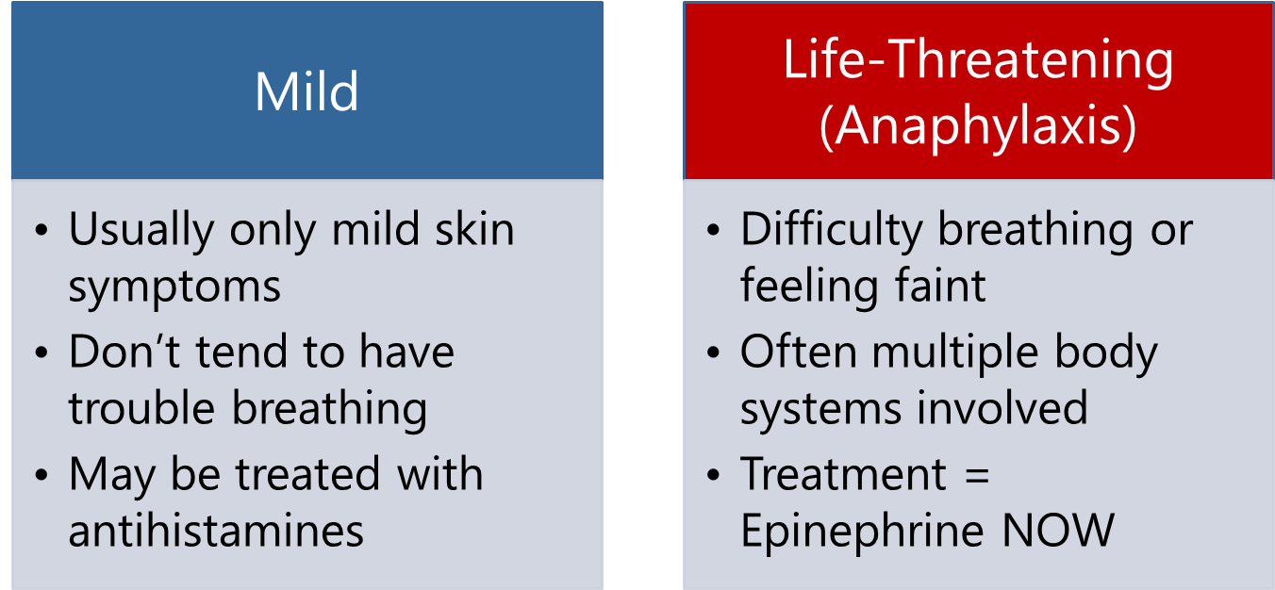
Allergic Reactions
Important to make the distinction based on the signs and symptoms seen in a student!
Fineman, 2014

Slide 12
Anaphylaxis (“an-a-fi-LAK-sis”)
Anaphylaxis is a severe allergic reaction that can be life-threatening in a matter of minutes
Almost always unanticipated
It must be treated immediately
The drug of choice is epinephrine
The time to learn how to give life-saving medication is NOW– it needs to be given without delay
It’s time to GET TRAINED!
Sicherer & Simons, 2007
Schoessler & White, 2013

Slide 13
Allergic Management
Preventing an exposure is key
For students with a diagnosed allergy:
Know who can help!
Talk to your school nurse or healthcare coordinator
Know how to react!
Know the signs and symptoms of anaphylaxis
Learn about the student’s Action / Emergency Care Plan
Know where your student’s medication is and how to help in an emergency
IF A CHILD IS HAVING A FIRST TIME REACTION AND DOESN’T HAVE A PLAN – DON’T DELAY USING EPINEPHRINE IF NEEDED
Robinson & Ficca, 2011

Slide 14
Allergy Management
Collaboration is vital – everyone should be aware of students with allergies
Must be willing to work as a team to keep these students safe
A Coordinated Approach / Effective Partnerships
CDC, 2013
Classroom Teachers | School Administration
Special Area Teachers | Food Service
Student Instructional Support Personnel | Facilities and Maintenance Staff
Transportation Staff | Everyone!

Slide 15
Signs and Symptoms

Slide 16
What does it look like?
Mild Allergic Reaction:
MOUTH: Itchy mouth
SKIN: A few hives around mouth/face, mild itch
ABDOMINAL AREA/ STOMACH:
Mild nausea/discomfort
FARE, 2015

Slide 17
What does it look like?
Anaphylaxis: Any SEVERE SYMPTOMS after suspected or known ingestion or exposure:
One or more of the following:
LUNG: Short of breath, wheezing, repetitive cough
HEART: Pale, blue, faint, weak pulse, dizzy, confused
THROAT: Tight, hoarse, trouble breathing /swallowing
MOUTH: Obstructive swelling (tongue and/or lips)
SKIN: Many hives over body
FARE, 2015

Slide 18
What does it look like?
Anaphylaxis: Any SEVERE SYMPTOMS after suspected or known ingestion or exposure:
Or combination of symptoms from different body areas:
SKIN: Hives, itchy rashes, swelling (e.g., eyes, lips)
ABDOMINAL AREA/ STOMACH: Vomiting, diarrhea, crampy pain
HEENT: Runny nose, sneezing, swollen eyes, phlegmy throat
OTHER: Confusion, agitation, feeling of impending doom
FARE, 2015

Slide 19
How will I know what to do?
School Nurse will develop an Emergency Care Plan for students with a diagnosed allergy
Includes steps to follow
Should be reviewed regularly
Includes information from the healthcare provider/allergist
Use school protocol if available
Ask: Are signs and symptoms of possible anaphylaxis present and was there an exposure to a possible trigger?
But be ready to respond if a child doesn’t have a plan
Be prepared to act!
NASN, 2014

Slide 20
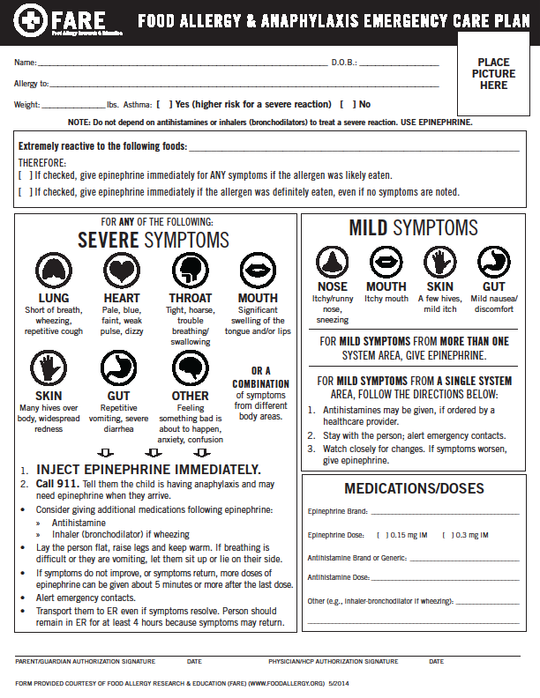
Allergy Action/Emergency Care Plan
Individual – specific to the student
Plan should be shared with school staff responsible for care
Information should be treated with care
Everyone should know where medication is and HOW TO REACT
FARE, 2014

Slide 21
Epinephrine Administration

Slide 22
Epinephrine
Epinephrine is the first line treatment for anaphylaxis
Should be administered IMMEDIATELY
Some protocols call for epinephrine to be administered with or without symptoms
Parents & school administrators should not be concerned about adverse health effects of epinephrine – it has an impressive safety profile
When in doubt – give the epinephrine
Adverse effects for average healthy child not harmful – anxiety, palpitations
A delay in treatment can have devastating results
Schoessler & White, 2013
Robinson & Ficca, 2011
Sicherer & Simons, 2007

Slide 23
Epinephrine Auto-Injectors
Epinephrine Auto-injectors are easy to use
Come with instructions
Trainers available for practice use
Websites have video demonstrations – know how to administer your student’s auto-injector!
Epi-Pen→ video | https://www.epipen.com/en/about-epipen/how-to-use-epipen
Adrenaclick→ | http://www.adrenaclick.com/how_to_use_adrenaclick_epinephrine_injection_USP_auto_injector.php
Generic | http://www.epinephrineautoinject.com/how_to_use_epinephrine_injection_USP_auto_injector.php#
Note: All Auvi-Q epinephrine injectors with expiration dates October 2015 – December 2016 were recalled from the market.

Slide 24
General Auto-injector Instructions
GET SPECIFIC DEMONSTRATION/TRAINING FROM YOUR SCHOOL NURSE
It is preferable to use training device from student’s brand of epinephrine auto-injector
Determine that the student requires epinephrine – use protocol or identify symptoms
Call 911 – have someone call EMS while you administer epinephrine
Check medication expiration date
NASN, 2014

Slide 25
General Auto-injector Instructions
1
Remove safety cap from auto-injector
Place auto-injector against outer thigh
2
Push auto-injector firmly against thigh until auto-injector activates *For small children, hold thigh firmly in place before injecting
3
Hold firmly in place (check directions for the auto-injector for length of time to hold: 3 seconds or 10 seconds)
Keep device to give to EMS
Massage site for 10 seconds

Slide 26
Steps to Follow in an Emergency
Follow the building emergency response plan/protocol and:
1. IMMEDIATELY ADMINISTER EPINEPHRINE AUTOINJECTOR PER STANDING ORDER:
0.15 mg of epinephrine for otherwise healthy young children weighing 10 to 25 kg (22 - 55 lbs.)
0.30 mg of epinephrine for those weighing 25 kg (55 lbs.) or more
Inject into middle outer side of upper leg, note time and site of injection (can be given through clothing)
Stay with student and monitor closely
2. Designate a person to call Emergency Medical System (911) and request ambulance with epinephrine
Sicherer, Scott H. and Simons, Estelle R. , 2007

Slide 27
Steps to Follow in an Emergency
3. Designate a person to notify, school administration, school nurse and student’s emergency contact(s)
Stay with and observe student until EMS (ambulance) arrives.
Maintain airway, monitor circulation, start CPR as necessary.
Do not have the student rise to an upright position.
Consider lying on the back with legs elevated position, but alternative positioning is needed for vomiting (side lying, head to side) or difficulty breathing (sitting).
Observe for changes until EMS arrives.
NASN, 2014

Slide 28
Steps to Follow in an Emergency
IF NO IMPROVEMENT OR IF SYMPTOMS WORSEN IN ABOUT 5 -15 MINUTES, (NIAID-Sponsored Expert Panel, 2010)
ADMINISTER A SECOND EPINEPHRINE DOSE according to local policy
Provide EMS with identifying information, observed signs and symptoms, time epinephrine administered, used epinephrine autoinjector to take with to the hospital
Transport to the Emergency Department via EMS even if symptoms seem to get better.
NASN, 2014

Slide 29
Document and Debrief
Discuss with the school nurse how to record that you gave an epinephrine auto-injector dose and the symptoms you witnessed
Have a debriefing meeting with the nurse and school administration after giving an epinephrine auto-injector
Talk about how response went
Talk about feelings
Talk about ways to improve in the future
Robinson & Ficca, 2011

Slide 30
You Can Do It!
You know what to do when a student is having a life-threatening allergic reaction
You know how to give epinephrine
You know how to save
the lives of children
like Bianca!
Bianca

Slide 31
YOU'VE BEEN EMPOWERED TO SAVE A LIFE!

Slide 32
Thank you for taking the time to
GET TRAINED
to administer an epinephrine auto-injector
in an emergency!

Slide 33
References
Guidelines for the Diagnosis and Management of Food Allergy in the United States: Report of the NIAID-Sponsored Expert Panel (2010). Journal of Allergy and Clinical Immunology, Volume 126 , Issue 6 , S1 - S58 http://dx.doi.org/10.1016/j.jaci.2010.10.007
Centers for Disease Control and Prevention (CDC). (2013). Voluntary guidelines for managing food allergies in schools and early care and education programs. Washington DC: US Department of Health and Human Services.
Fineman, S. (2014). Optimal treatment of anaphylaxis: antihistamines versus epinephrine. Postgraduate Medicine, 126 (4), 73-81. doi: 10.3810/pgm.2014.07.2785
Food Allergy Research and Education (FARE) (2014). Retrieved from: http://www.foodallergy.org/

Slide 34
References
National Association of School Nurses (NASN). (2014) Sample protocol for treatment of anaphylaxis. Retrieved from: http://www.nasn.org/portals/0/resources/Sample_Anaphylaxis_Epinephrine_Administration_Protocol.pdf
Robinson, J. & Ficca, M. (2011). Managing the student with severe food allergies. Journal of School Nursing, 28(3), 187-194. doi: 10.1177/1059840511429686.
Schoessler, S. & White, M. (2013) Recognition and treatment of anaphylaxis in the school setting: The essential role of the school nurse. NASN School Nurse, 29: 407-415. doi: 10.1177/1059840513506014
Sicherer, S. & Simons, F.E. (2007). Self-injectable epinephrine for first aid management of anaphylaxis. Pediatrics, 119(3), 638-646. doi: 10.1542/peds.2006-3689.

